Slide 1
Biometric Security and Privacy
Module 1.1
By Bon Sy
Queens College/CUNY, Computer Science

Slide 2
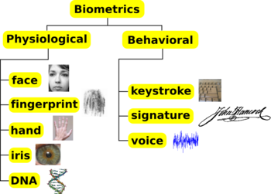
Objective of biometrics
Towards the development of automatic system for recognizing a person based on physiological or behavioral characteristics.
Generic taxonomy

Slide 3
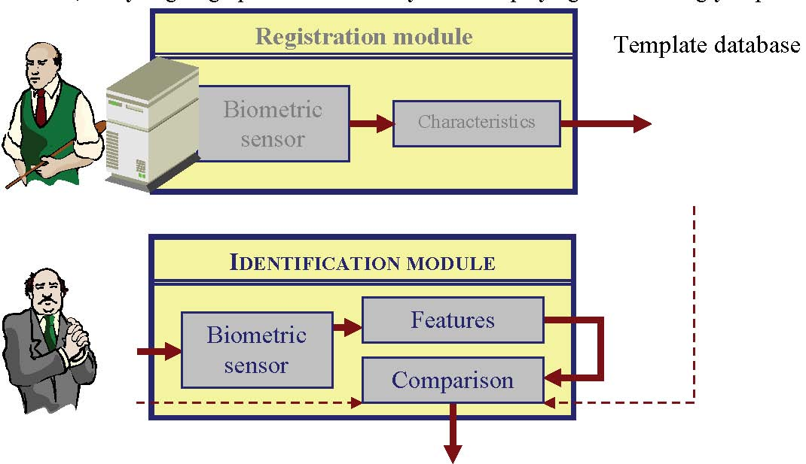
General biometric system
Source: Evaluation of Fingerprint Recognition Technologies – BioFinger; Bundesamt fur Sicherjeit in der Informationstechnik

Slide 4
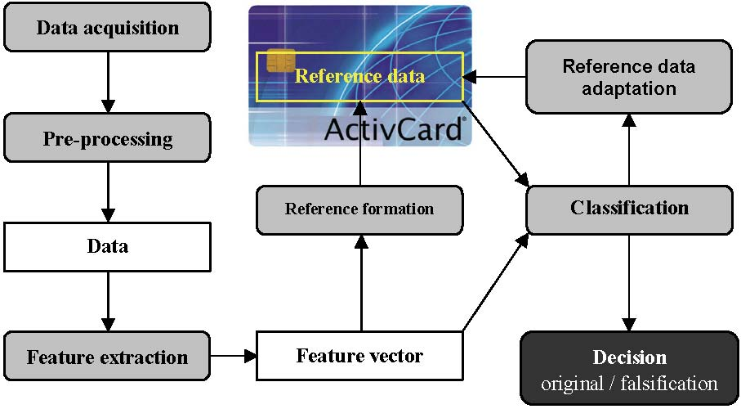
Steps for biometric verification
Source: Evaluation of Fingerprint Recognition Technologies – BioFinger; Bundesamt fur Sicherjeit in der Informationstechnik

Slide 5
What exactly is a pattern and a pattern classifier?
A pattern is a structure governed by rules…
    Pattern theory [Grenander 1993 & 1996], Information theory [Shannon 1948, Tufte ]
Concept used in software design and information display – explains complex phenomena through pattern formation and deformation.
Provides backdrop for science and technology training — modeling process for engineering design and scientific analysis
  Allows there to be links among various learning approaches

Slide 6
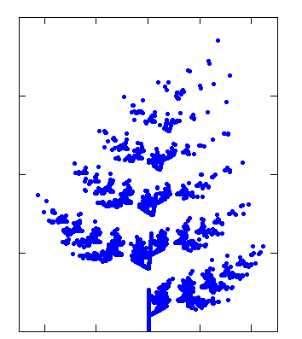
An example of a pattern
Exhibits regularity
  Consistent behavior of data
  Elegant properties for generalization and prediction
  Examples:
    Fern fractal
    Tornados (weather phenomenon with a spiral rotating wind circulation)

Slide 7
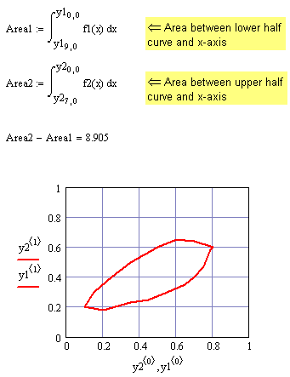
Three components of a pattern
Leaf Experiment, Part 1
Mathematical structure
  Functional expression
Visual model
  Concept abstraction
Graphical model
  Qualitative interrelationship

Slide 8
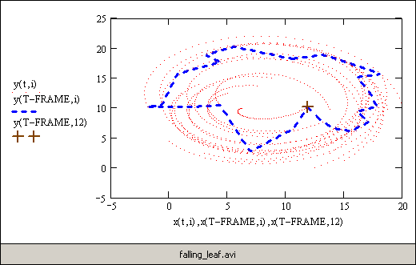
Extending pattern development
Leaf Experiment, Part 2
Using randomization to “perturb” pattern
Animating results

Slide 9
Four kinds of pattern manipulation
Derivation
  Homogenous transformation ⇒ Structure discovery
Synthesis
  Concept abstraction ⇒ Visualization
Analysis (and Exploration)
  System identification ⇒ Mathematical function discovery
Summary
  Relationship declaration ⇒ Dependency/decision model

Slide 10
Interrelationships among pattern manipulation
FROM \ TO
Mathematical
Visual
Graphical Dependency
Mathematical
Derivation
Synthesis
Summary
Visual
Analysis
Derivation
Summary
Graphical Dependency
Analysis
Synthesis
Derivation

Slide 11
Mathcad Examples
Each file demonstrates:
  Deriving graphical representation from algebraic representation
  Synthesizing relationship between abstract (mathematical structure) and concrete (visual representation)
  Exploring underlying relationship or model by varying parameters and analyzing graphical or numerical results
  Summarizing dependency relationship or building model

Slide 12
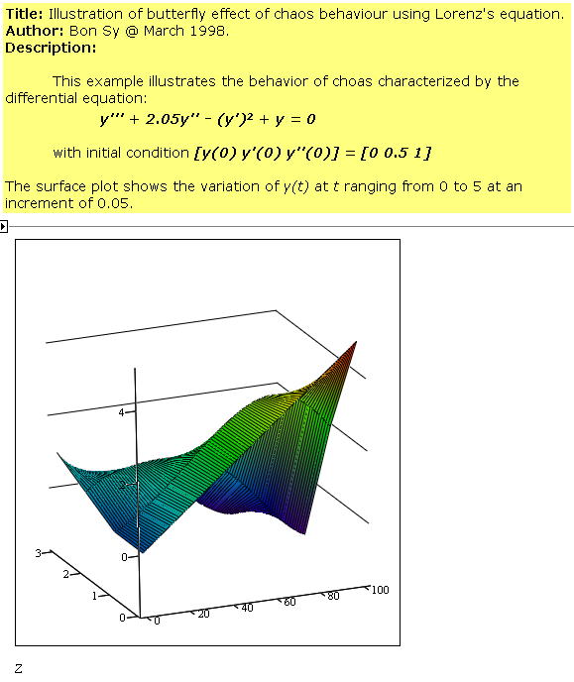
Lorenz
Attractor
MCD

Slide 13
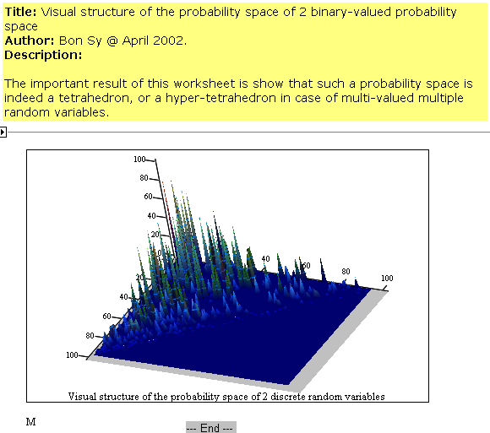
Visualizing a probability space
MCD
Same track
for visualizing
the computational
geometry of a
biometric system!

Slide 14
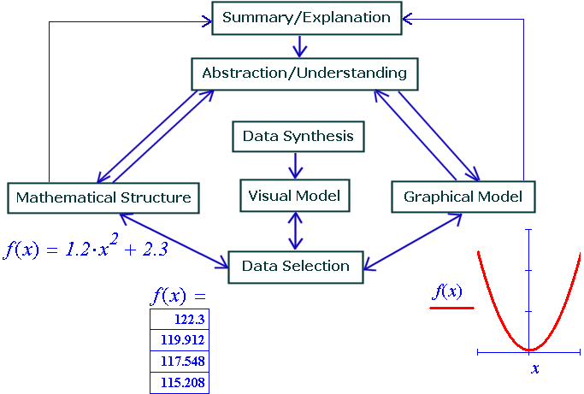
General framework for pattern abstraction
Pattern
Abstraction

Slide 15
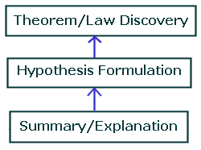
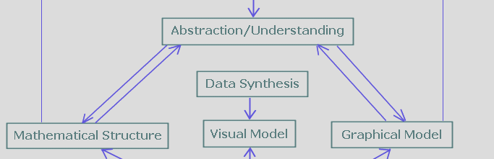
General framework for pattern abstraction
Concept
Formulation

Slide 16
Mechanism for pattern modeling and learning
Explore through visualization
  Discover dependency structure
Analysis based on regression analysis
  Discover mathematical structure
Pattern synthesis based on mathematical structure
  Discover visual structure
Compare and validate
  Summary and explanation

Slide 17
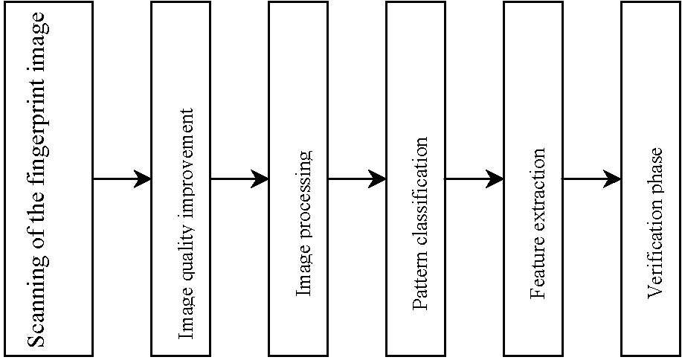
Fingerprint pattern and security application (verification)
Source: Evaluation of Fingerprint Recognition Technologies – BioFinger; Bundesamt fur Sicherjeit in der Informationstechnik

